Slide 1
Sujeet Kumar BITS Id 2018ad04062
Statistics Assignment : 24 Sept 2019

Slide 2
Problem No 1: Testing of Hypothesis
A manufacturing company claims that the mean breaking strength of the cables supplied s 1500 with a standard deviation of 100.A sample of size 9 cables tested is having mean breaking strength of 1600 with a standard deviation of 30. If the distribution of the mean breaking strength is normal, does this support the claim at 1% level of significance?
Use z – statistic to validate the claim
Use t – statistics to validate the claim
Repeat the same at 5% level of significance
Based on (a),(b) and (c) write your observations , comments and suggestions

Slide 3
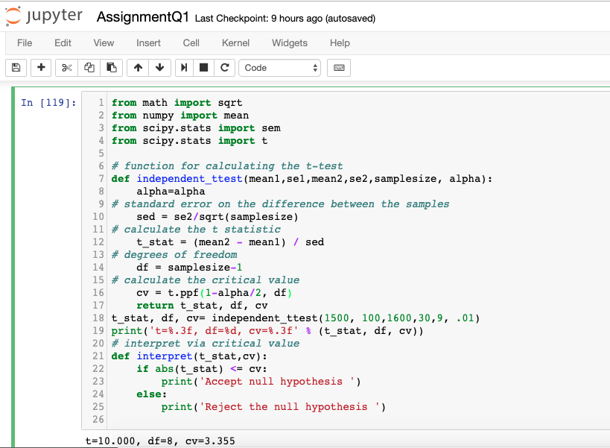
t-test implementation(Python)

Slide 4
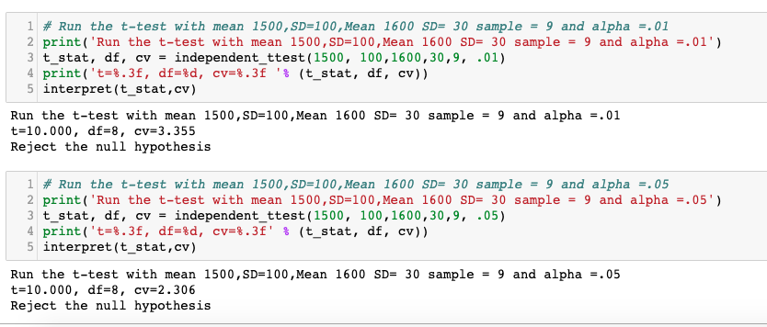
t-test output : alpha =1% and 5%

Slide 5
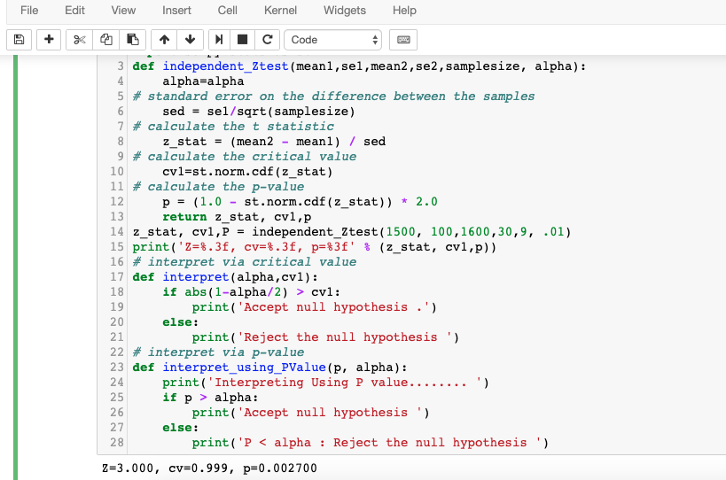
Z-test implementation(Python)

Slide 6
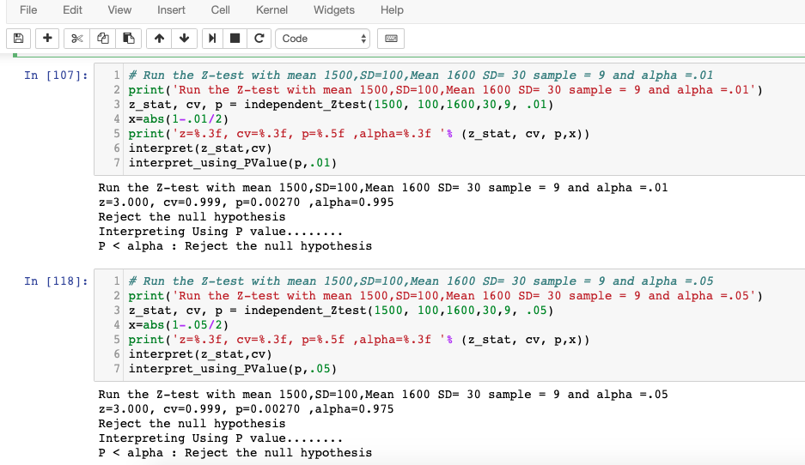
Z-test output : alpha =1% and 5%

Slide 7
T-test : Observation/Comments/Suggestions
t-test (alpha =5% and 1%)
P values equals 0.00000848.This means change of type-1 error is small. Smaller p value the more it supports Ha.
t-test(alpha =5%)
Test statistics t equals 10 is not in the 95% critical value accepted range [-2.306,2.306]. Mean =1600 is not acceptance in 95% range.
t-test (alpha = 1%)
Test statistics t equals =10 is not in range of 99% critical value accepted range
[-3.3554,3,3554].Mean =1600 is not accepted in 99 % range
(Sample size =9 < 30), suggests we should go for t-statistical test
Ps: Scan document of solution Is attached

Slide 8
Z-test : Observation/Comments/Suggestions
z-test (alpha =5% and 1%)
P values equals 0.0026.This means change of type-1 error is small. Smaller p value the more it supports Ha.
z-test(alpha =5%)
Test statistics z=3.0 is not in the 95% critical value. Mean =1600 is not accepted in 95% range.
z-test (alpha = 1%)
Test statistics z=3.0 is not in range of 99% critical value. Mean =1600 is not accepted in 99 % range
(Sample size =9 < 30), suggests we should go for t-statistical test
Ps: Scan document of solution Is attached

Slide 9
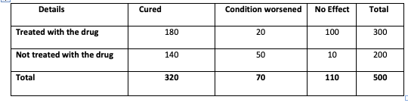
Problem No 2: Effectiveness of the drug.
An experiment was conducted to test the effectiveness of the drug. 300 patients were treated with new drug and 200 were not treated with the drug. The data is given below. Use an appropriate test and comment on the effectiveness of the drug.

Slide 10
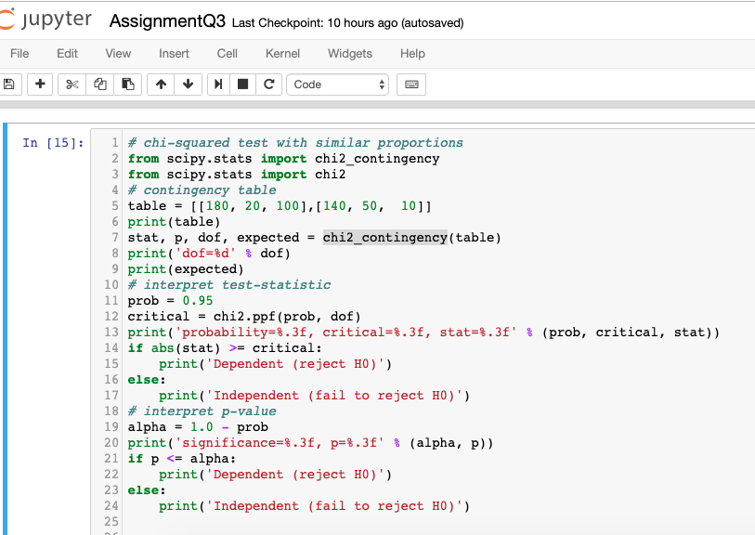
Chi-square implementation(Python)

Slide 11
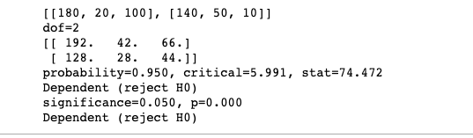
Chi-square: output
Ps: Solution scan copy is attached

